Slide 1

DATA STANDARDS FOR INTEROPERABILITY
Paul Wormeli
Co-Chair
NIEMOpen Business Architecture Committee

Slide 2

AXIOM
Information Sharing is at the heart of the criminal justice enterprise

Slide 3
Justice Information Sharing
Investigation
Release
Police
Cases
Arrests
T
E
S
T
I
M
O
N
Y
Supervision
Detention
Parole
Booking
Prison/Jail
Corrections
Prosecutor
Courts
Cases
Sentences
Notes:
This diagram depicts the linkages between the various agencies. Information is needed throughout this process. Information is generated at each level that other entities in this process require for a variety of decision-making needs.

Slide 4
Criminal Justice Information Flow
Arrest
Intake
Prosecution
Adjudication
Arrestee
CCH Check
Charges
Medical data
Identification
Mug Shot
Property
Filing
Times
Disposition
Complainant
Victims
Witnesses
Suspects
Vehicles
Property
Offenses
Crime detail
Event description
Action taken
Additional names
Statements
Photographs
Evidence
Property
Case scheduling
Jury/witnesses
Disposition
Sentence
Release
CRIMINAL JUSTICE DATABASE(s)

Slide 5
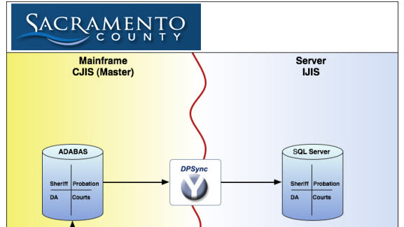
Early CJIS monolithic systems

Slide 6
Late 20th century architectures
State/federal
Repositories
Message Switch
Law enforcement
Prosecutor
Courts
Corrections

Slide 7
Obstacles to sharing information
The numbers game—What is a case?
Matching records—Which John Smith is it?
Proprietary architectures and data—Who owns the data?
Incompatible database designs—Computerspeak variations in data
Varying structures in separate silos—the inward focus

Slide 8

The next generation
For the 21st century

Slide 9

Key Features
Person-centric data integration
Electronic case folder—a 360-degree view
Integrating structured and unstructured data sources
Seamless workflow management across agencies
Notification and alerts
Flexible output reporting
Full video/audio integration
Distributed data management
Deployable anywhere (on-premise or on any cloud)

Slide 10

Key technologies
Digital evidence management across agencies
Interaction of body-worn, dash, and surveillance cameras
Knowledge graph technologies to define business rules and data relationships
Entity resolved knowledge graph
Generative AI to construct inquiries
Standards-based AI for data extraction
Multi-dimensional business intelligence
AI-based video and audio integration

Slide 11

Data Interoperability
2025
Notes:
Welcome – Introduction.

Slide 12

Enable Interagency And Cross-Domain Information Sharing
Mission:

Slide 13


Semantic and syntactic data standards
LEGACY
DATABASES
INTERFACE
COMMONLY FORMATTED DATA
INTERFACE
LEGACY
DATABASES
NIEMOpen
Community-based data standards for information exchanges and building enterprise ontologies

Slide 14
The Voices
Of NIEMOpen
An OASIS Open Project
Local
State
Federal
International
Industry
COLLABORATION
Private
Sector
CONSENSUS
Tribal/Territorial
Academia
Non-Profit
EQUALITY

Slide 15
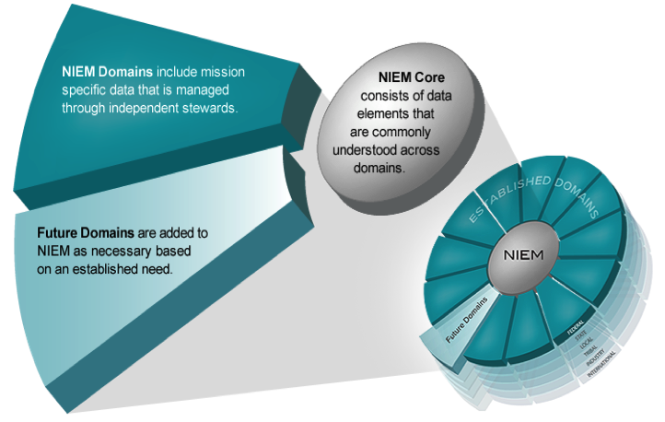
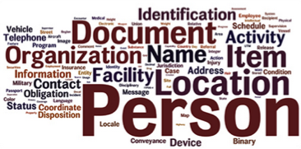
NIEMOpen Model Content
See more at
NIEMOpen.org
NIEMOpen has 17 Domains
Agriculture
Biometrics
Chemical, Biological, Radiological, & Nuclear
Cyber
Emergency Management
Human Services
Immigration
Infrastructure Protection
Intelligence
International Trade
International Human Services
Learning & Development
Justice
Maritime
Military Operations
Screening
Surface Transportation
Features
20,000+ harmonized data components
Naming and design rules
Common model format supporting XML,JSON, RDF
Open source API and development tools
Notes:
Let’s take a look at a basic example of the NIEMOpen core and the NIEMOpen domain relationship.
All domains would agree that a person has a name and date of birth—commonly agreed-upon characteristics of a person.
Some communities have a business need to extend the definition of a person based on their information exchange requirements. For example, within the Justice community, they need the flexibility to extend Person to capture additional information of a Subject, who may be involved or suspected of being involved in an incident or criminal activity. In addition, a name and date of birth are not sufficient to identify a Subject. They also may require biometric identifiers such as fingerprints, scars, or tattoos to verify their identity.
Another commonly used core element is Activity. For example, the Cyber Domain may need to extend Incident such as a breach event to include additional identifiers such as IP Address or Type to create context.

Slide 16
NIEMOpen Offers
16
An open standard format for data specifications across justice participants
Reuse of community-agreed data models, with local extensions
A technology-neutral data modeling language
Knowledge graph representation of exchanged data
A methodology to define exchange standards
Automated validation of information exchanges to improve data quality
Interoperability with other jurisdictions and disciplines
Notes:
Another point to highlight is that you may be using NIEMOpen and not even know it.
NIEMOpen has been incorporated and leveraged by several other industry standards as identified on this slide. If you are currently using any of these standards, you are technically using NIEMOpen as well.

Slide 17
NIEMOpen--an Open Source standard
Aligns with the National Institute of Standards and Technology
Consistent with government and industry formal standards
Inherent Interoperability due to rigor in vetting standards
Potential to be an ANSI or ISO standard
Increased visibility, contribution, and use by open-source tool developers
Free to all users in government or industry
Notes:
National Technology Transfer and Advancement Act of 1995 (NTTAA), Public Law 104-113 requires all federal government agencies to use, wherever feasible, standards developed or adopted by voluntary consensus standards bodies in lieu of developing government-unique standards or regulations
OMB 119 maintains a strong preference for using voluntary consensus standards over government to unique standards in Federal regulation and procurement
NIEM included in other standards
ANSI 42.42 Radiological Nuclear detectors
ANSI APCO Alarm Monitoring Company to Public Safety Answering Point (PSAP)
OASIS EXDL FEMA
NIST Big Data Framework Vol 7
Nation Fire Protection NFPA 950 calls for compliance with NIEM. Emergency Incident Data Document (EIDD) IEPD – NISTIR 8255
Biometrics ANSI/NIST ITL Standard
Biometric Conformance Test Software (BioCTS)
BioCTS for AN-ITL v2 is a desktop application which tests electronic biometric data files, known as transactions, for conformance to NIST Special Publication (SP) 500-290
Conformance Test Architecture (CTA) and Test Suite (CTS) called "BioCTS for AN-2011 NIEM XML" designed to test implementations of AN-2011 NIEM XML encoded transactions.
NIEM Cited in patent – Integrated Environment for Developing Information Exchanges patent No: US 8,769,480 B1 Dated July 1, 2014
Combination of Interoperability Registries with Process and Data Management tools for Governmental Services

Slide 18
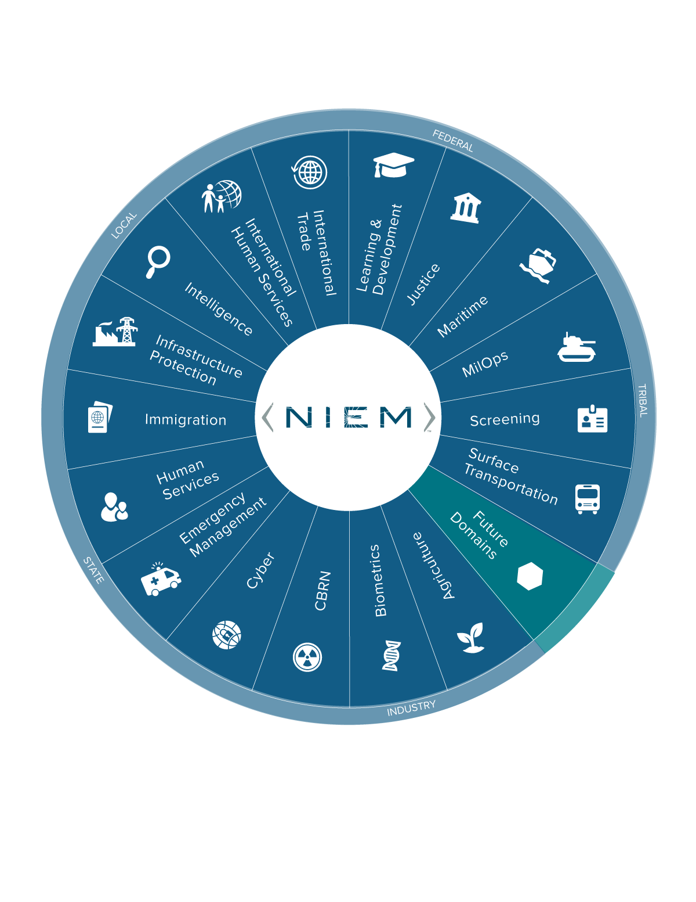
NIEMOpen Is About Cooperation, Not Control
Data components chosen and harmonized by consensus among users
Components are established when participants believe that a common definition will make their exchanges easier to create and implement
Each domain changes on its own schedule, under its own control
Changes in the core or in a domain do not force changes in other domains or in any data exchange
No one is ever required to use a component that does not satisfy the data exchange needs, so there is no leverage for controlling the participants

Slide 19

NIEM IMPACT
ON pharmaceutical drug monitoring
The Standard Prescription Monitoring Information Exchange

Slide 20


Open Knowledge Network:
[...] multi-domain access to linked data in a federated system, accessed by natural language queries, empowered by artificial intelligence.

Slide 21
A Vision for Law Enforcement/Public Safety Information Sharing
UNCLASSIFIED
Brian D. Griffith
Deputy Assistant Director
Criminal Justice Information Services Division
Federal Bureau of Investigation
UNCLASSIFIED

Slide 22

A Bold Vision for FBI CJIS
Create a roadmap for adopting NIEM Open standards across CJIS systems
Increase availability of Full Lifecycle LE/PS data via NCIC–carefully
Increase availability of LE/PS data via agency RMS (API?)
Explore the concept of a LE/PS Data Sharing Fabric
--Brian Griffith

Slide 23

Solution Extensions
Feed data to criminal history repositories (District, national)
Coordinate and consolidate criminal intelligence data
Manage interaction between justice, healthcare and social services
Generate input to national statistical systems
Create a public-facing interactive dashboard to promote transparency
Manage police and prosecutor diversion programs, pre-trial services

Slide 24


Slide 25
NIEMOpen.org

